Slide 1
ENGI 301 Project 2: IcyHot PCB
December 12, 2020
Brian Dinh

Slide 2
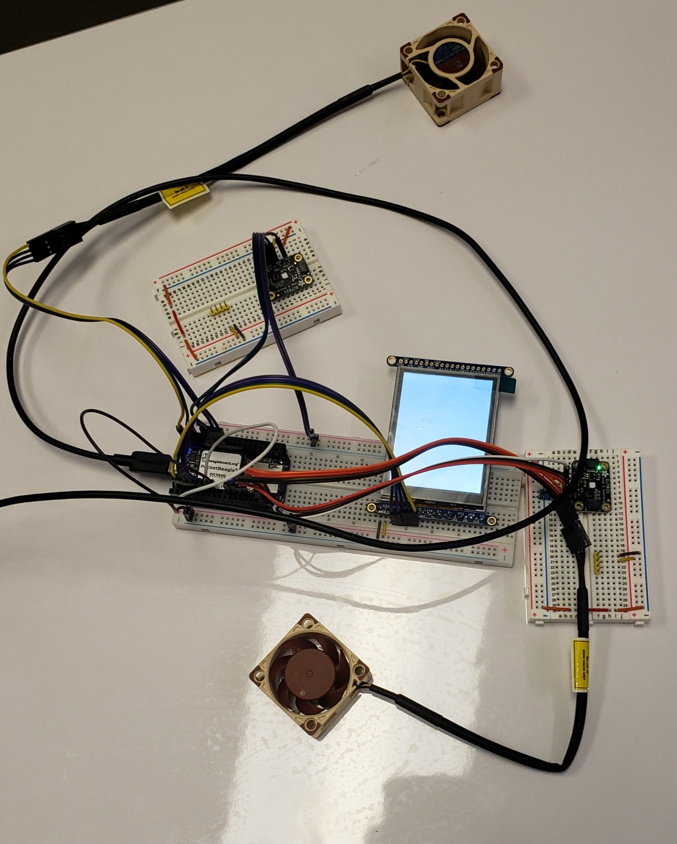
Background Information & Description of Board Functionality
What is being proposed?
PCBs for two components:
PocketBeagle design from Project 1- what was successfully completed (exclude the LED screen)
555 LED blinker
Links to existing projects / libraries
https://www.hackster.io/brian-dinh-rice2021/rice-university-engi-301-project-1-icyhot-7e1a75
https://www.hackster.io/eric-schneider/555-timer-led-blinkie-b26ecf
Description of board functionality:
Use results from Project 1 to transport it onto a PCB
Implement components that were not completed in Project 1 for

Slide 3
Detailed Description of Board Functionality
Project 1 IcyHot Components:
2 temperature sensors
2 PWM fans
What’s being expanded upon?
Design PCB involving all components from IcyHot
Inclusive of components not implemented
Add a second library component—project requirement
Second library component:
TPS92411x Floating Switch for Offline AC Linear Direct Drive of LEDs with Low Ripple Current
Complements LED screen

Slide 4
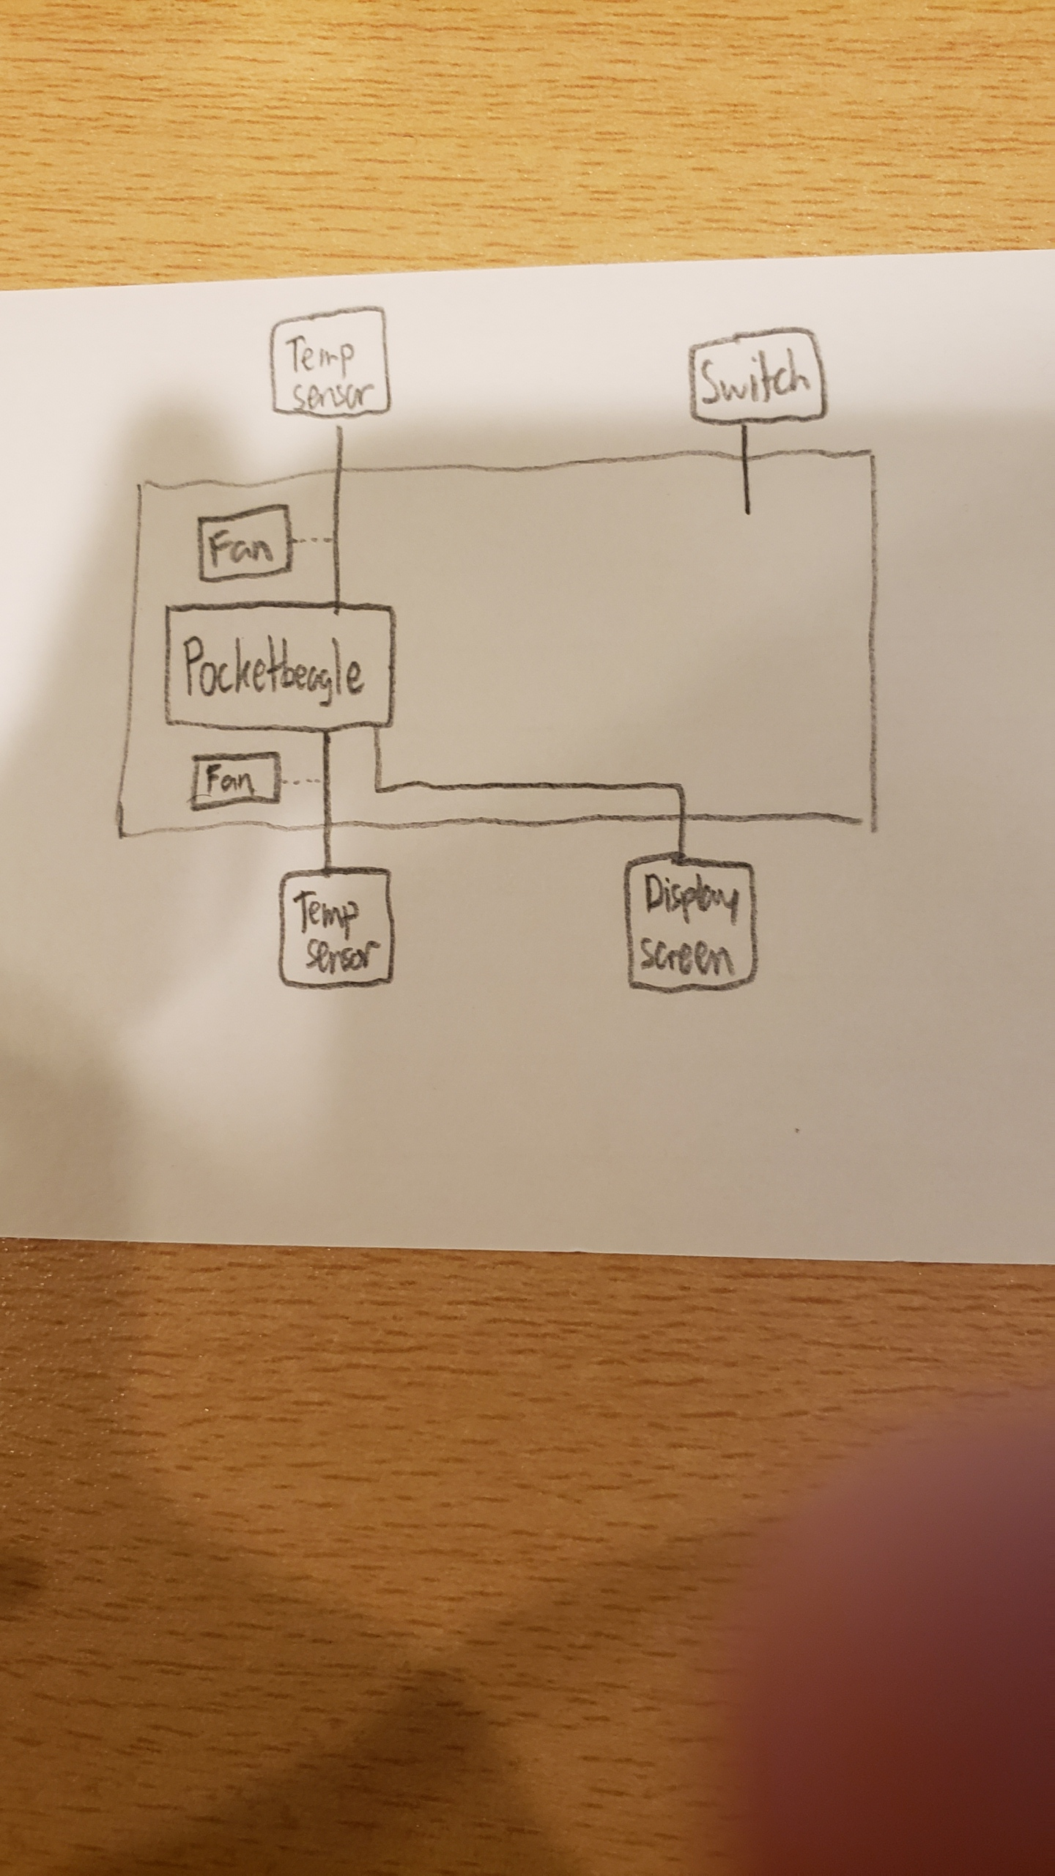
Functional Block Diagram

Slide 5
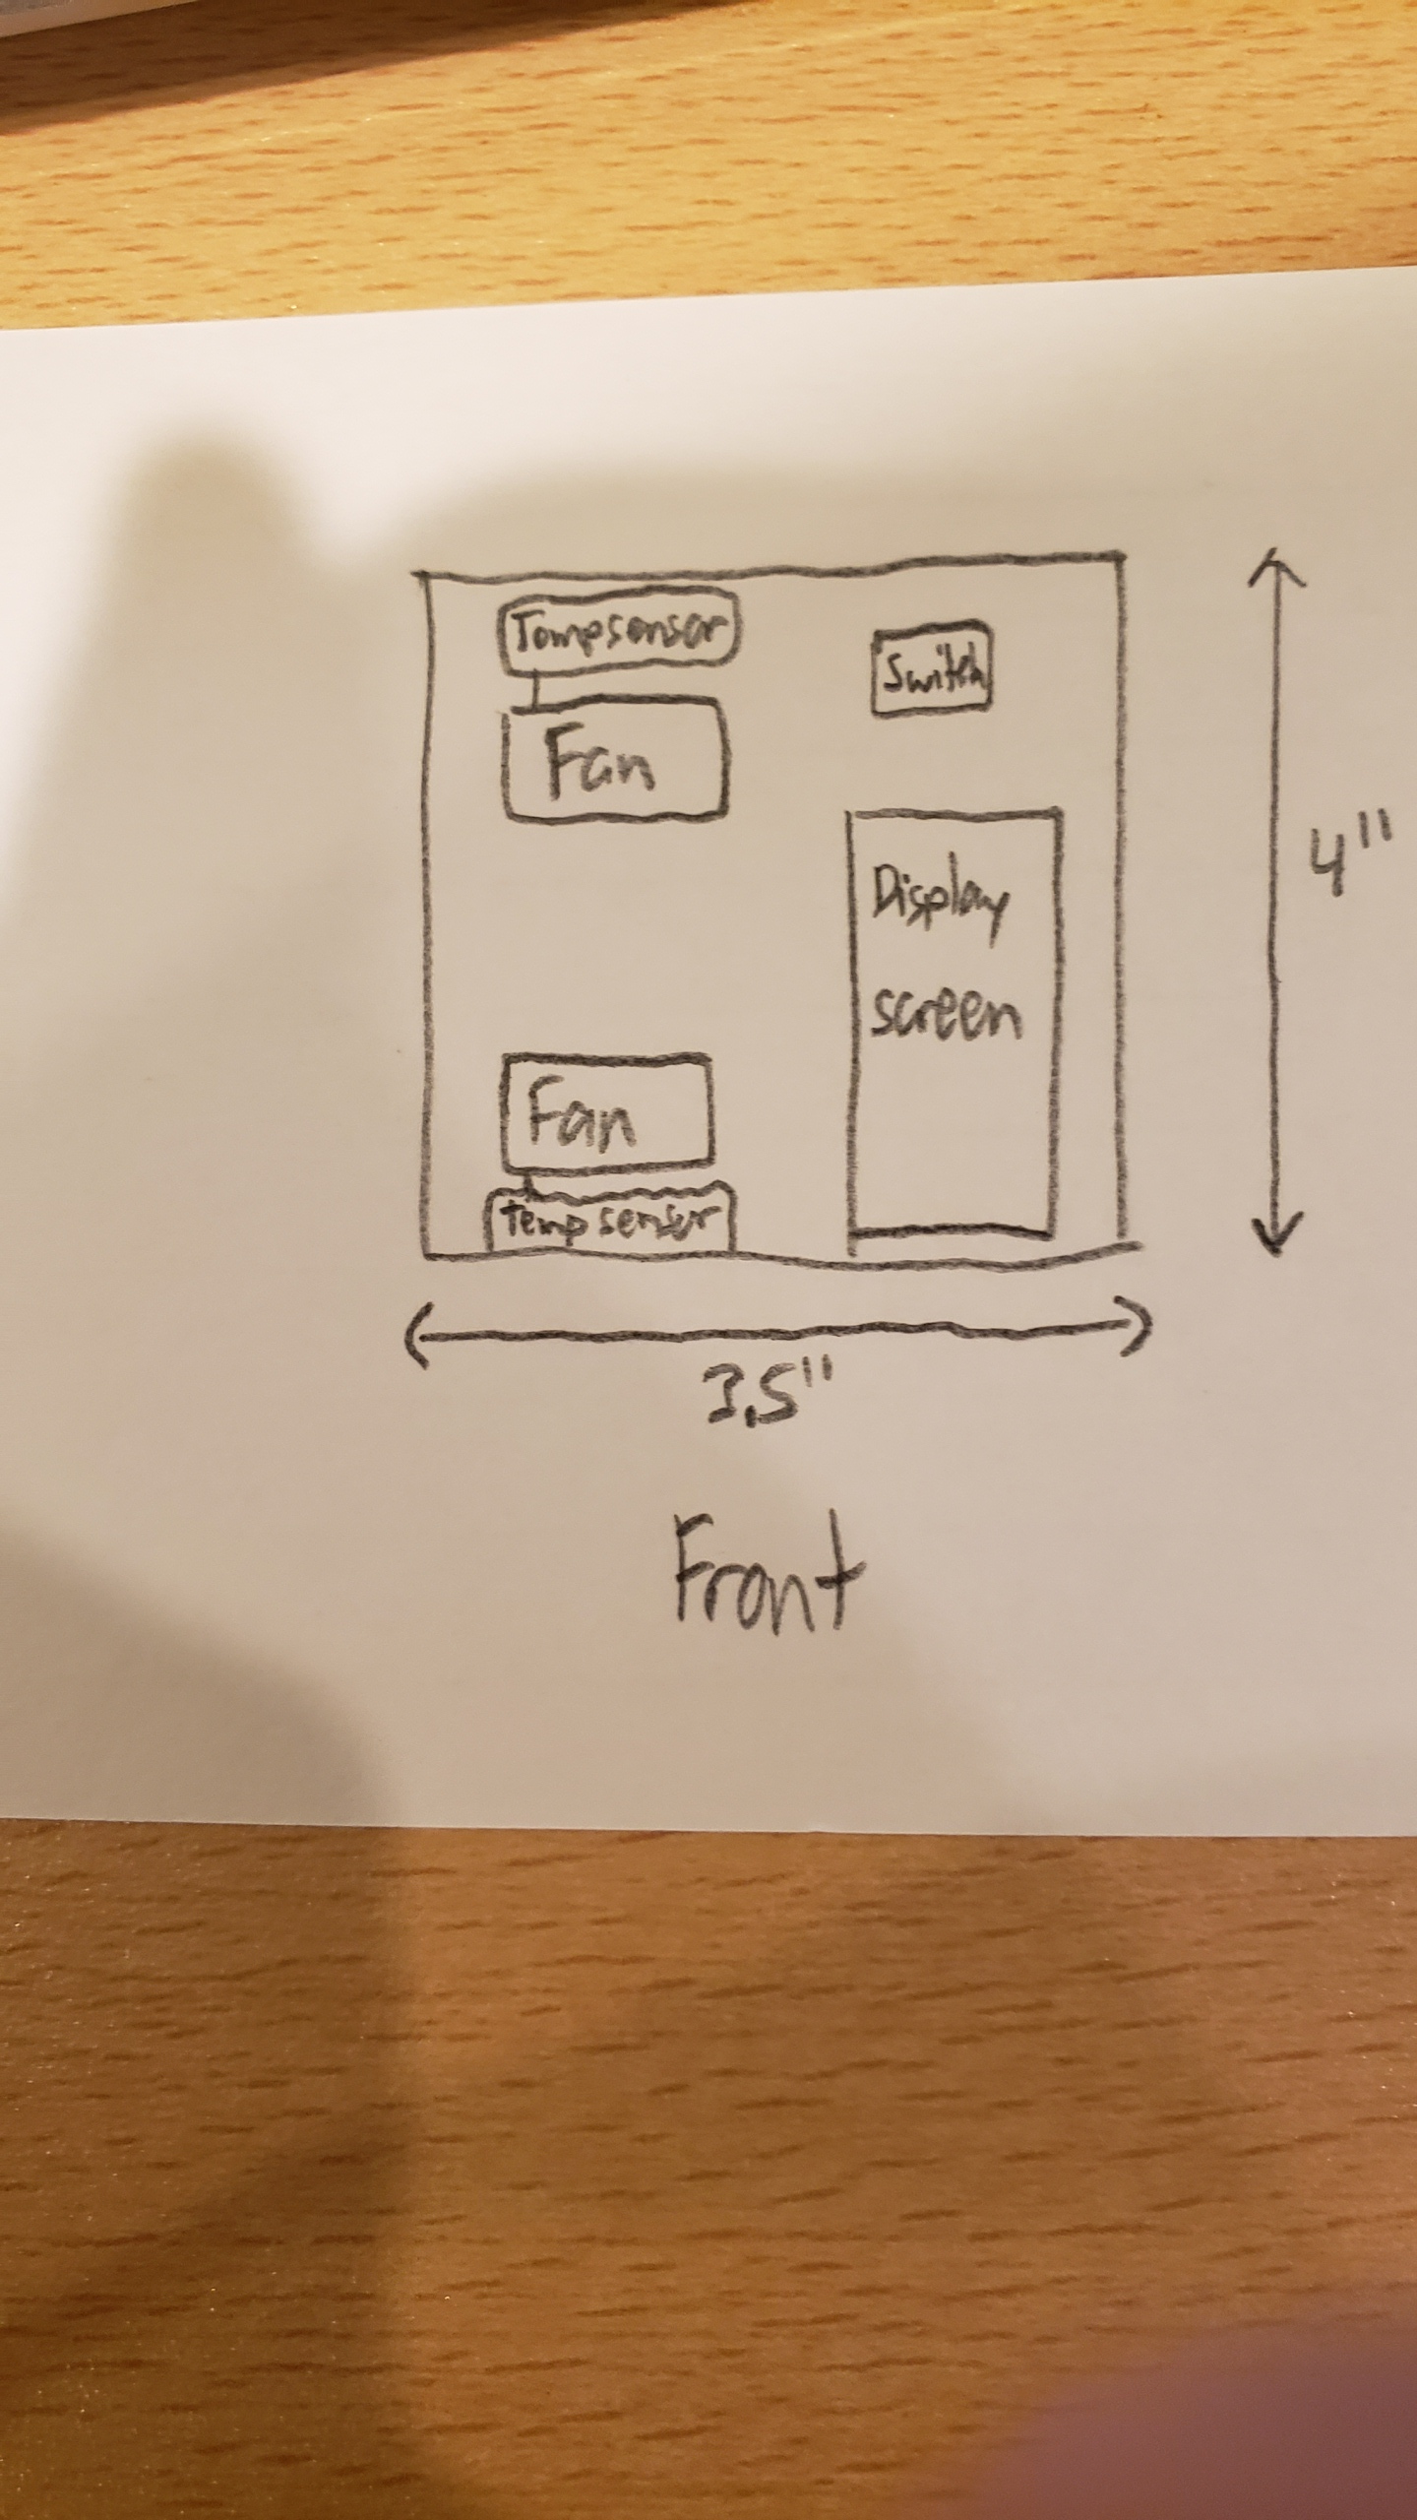
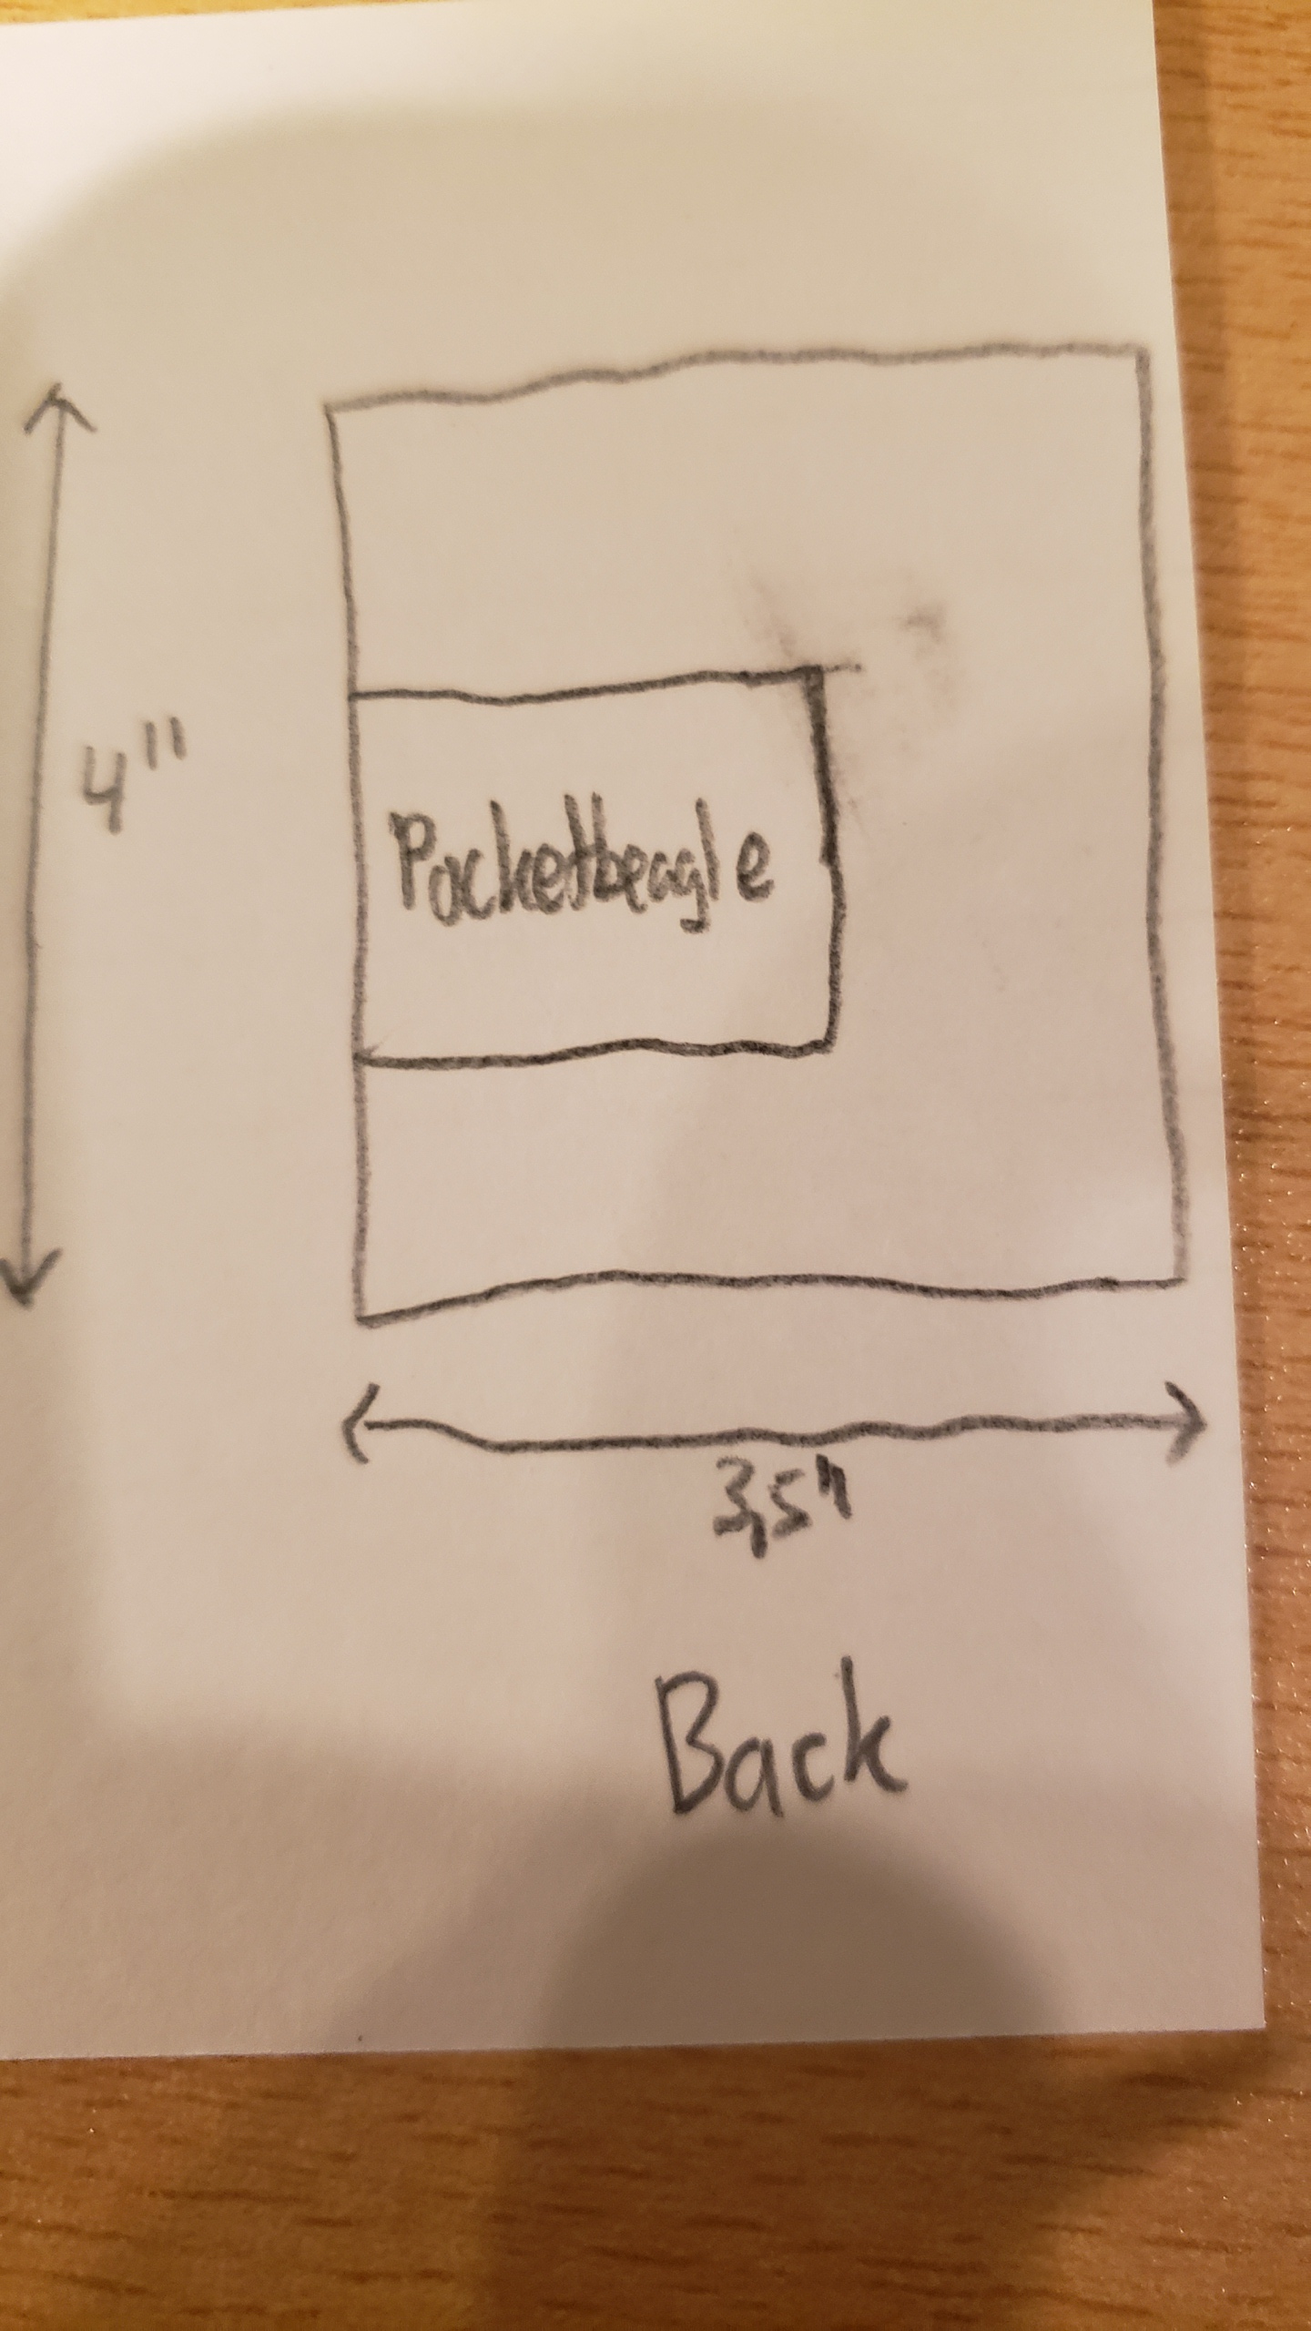
Mechanical Block Diagram: Dimensions of PCB

Slide 6
Components / Budget
Component | Need to Buy | Cost (USD)
None | --------- | ---------
Total |  | ---------

